Slide 1
Machine Learning
Linear Regression Notes

Slide 2
Concepts in Machine Learning (ML)
Model: An algorithm that describes/predicts an outcome, based on the observed data.
Fitting: A model trained (fitted) in a dataset to learn patterns, relationships, or trends within that data.
Underfitting: A model achieves poor performance in the training data.
Overfitting: A model achieves great performance in the training (known) data, but it fails to generalize well in unseen (new) data.
Generalization: The model’s ability to make good predictions in both training and unseen data.
Weights/Coefficients: The parameters of a model that need to be found by training it in a dataset.
Hyperparameters: The settings of an ML algorithm.
Hyperparameter Tuning: The process in which several settings (hyperparameters) are adjusted for a specific dataset.
Observations/Samples: The number of paradigms (rows) in a dataset.
Features: The attributes (columns) of an observation (e.g. the features of a weather dataset could include Temperature, Humidity, Atmospheric Pressure, etc.).
Labels/Targets: The feature, whose value is unknown and needs to be predicted.

Slide 3
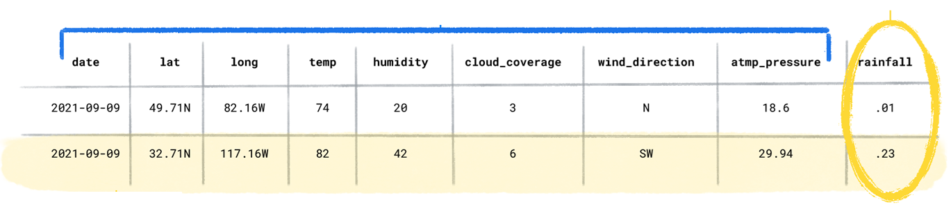
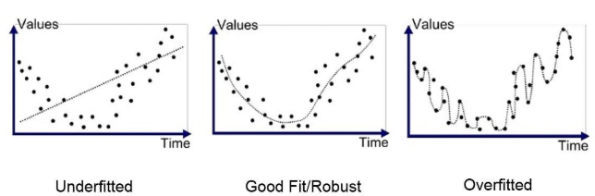
ML Concepts Example
Dataset
Features (Columns)
Target
Samples (Rows)
Sample 1
Sample 2
….
A model that is trained to estimate the rainfall over the time.

Slide 4
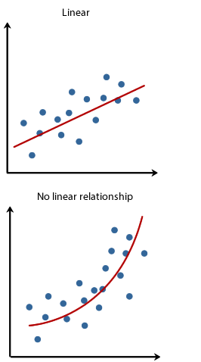
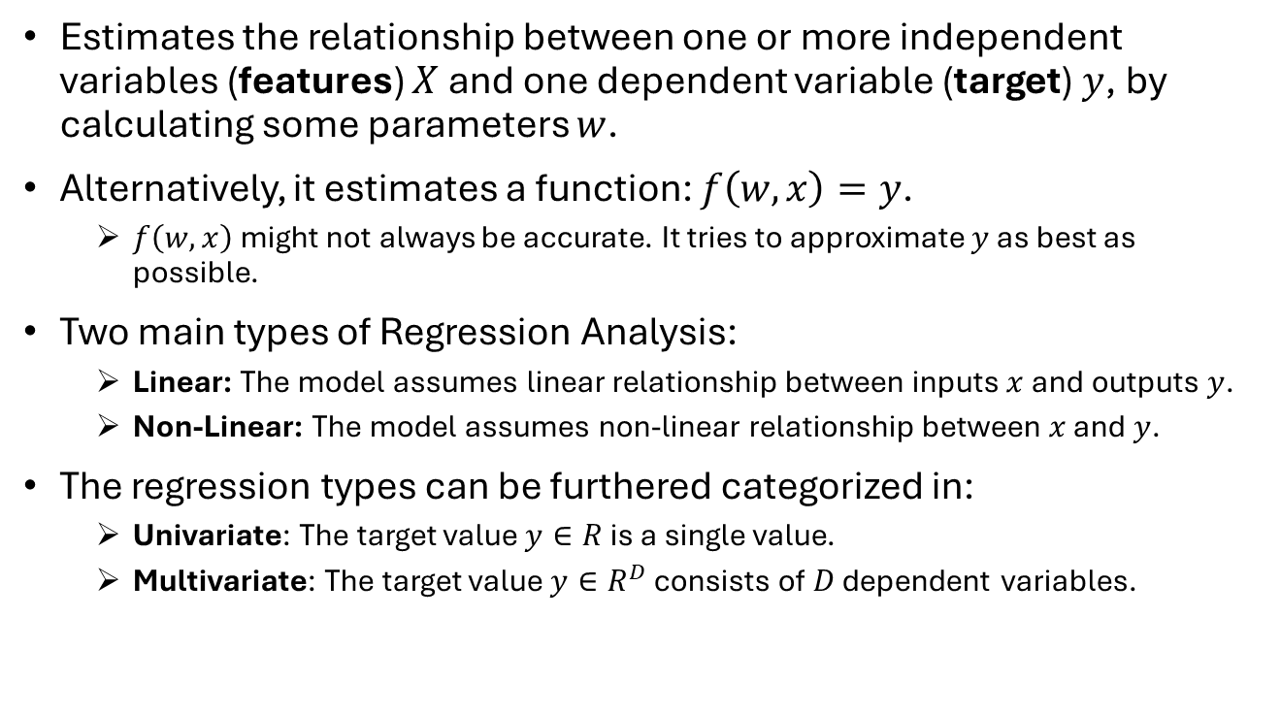
Regression Analysis
Estimates the relationship between one or more independent variables (features) $X$ and one dependent variable (target) $y$, by calculating some parameters $w$.
Alternatively, it estimates a function: $f\left(w,x\right)=y$.
$f\left(w,x\right)$ might not always be accurate. It tries to approximate $y$ as best as possible.
Two main types of Regression Analysis:
Linear: The model assumes linear relationship between inputs $x$ and outputs $y$.
Non-Linear: The model assumes non-linear relationship between $x$ and $y$.
The regression types can be furthered categorized in:
Univariate: The target value $y∈R$ is a single value.
Multivariate: The target value $y∈R^{D}$ consists of $D$ dependent variables.

Slide 5
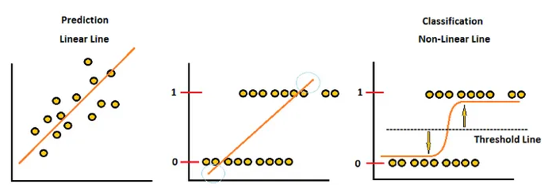
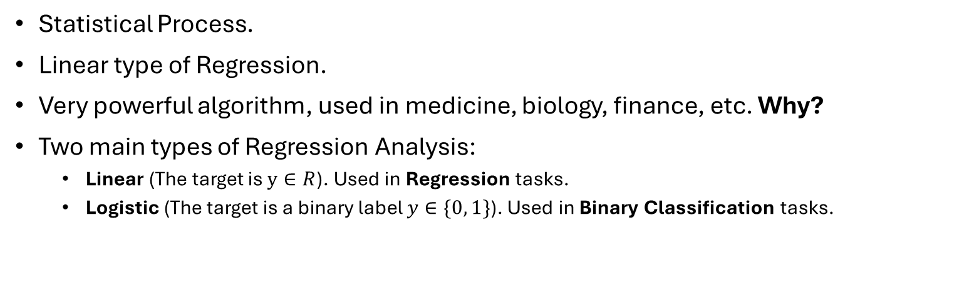
Linear Regression
Statistical Process.
Linear type of Regression.
Very powerful algorithm, used in medicine, biology, finance, etc. Why?
Two main types of Regression Analysis:
Linear (The target is $y∈R$). Used in Regression tasks.
Logistic (The target is a binary label $y∈\{0, 1\}$). Used in Binary Classification tasks.
Linear Regression
cannot be used in
Classification
Logistic Regression

Slide 6
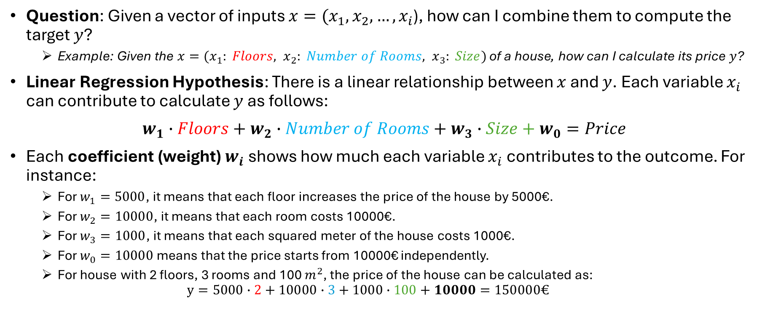
Linear Modeling
Question: Given a vector of inputs $x=(x_{1},x_{2},…,x_{i}$), how can I combine them to compute the target $y$?
Example: Given the $x=(x_{1}: Floors, x_{2}: Number of Rooms, x_{3}: Size)$ of a house, how can I calculate its price $y$?
Linear Regression Hypothesis: There is a linear relationship between $x$ and $y$. Each variable $x_{i}$ can contribute to calculate $y$ as follows:
$w_{1}∙Floors+w_{2}∙Number of Rooms+w_{3}∙Size+w_{0}=Price$
Each coefficient (weight) $w_{i}$ shows how much each variable $x_{i}$ contributes to the outcome. For instance:
For $w_{1}=5000$, it means that each floor increases the price of the house by 5000€.
For $w_{2}=10000$, it means that each room costs 10000€.
For $w_{3}=1000$, it means that each squared meter of the house costs 1000€.
For $w_{0}=10000$ means that the price starts from 10000€ independently.
For house with 2 floors, 3 rooms and 100 $m^{2}$, the price of the house can be calculated as: $y=5000∙2+10000∙3+1000∙100+10000=150000€$

Slide 7
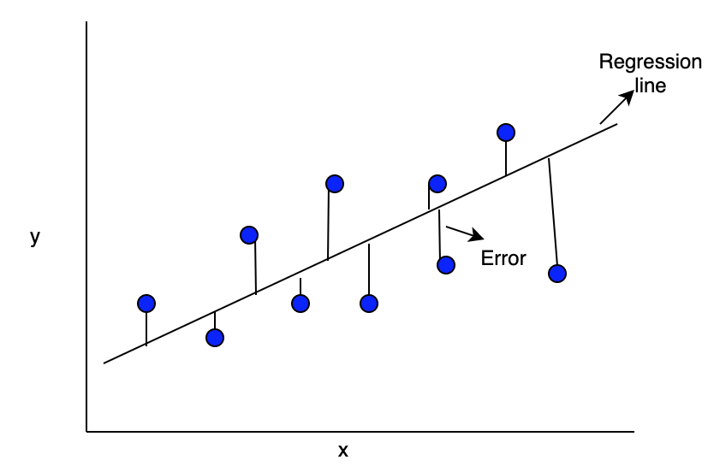
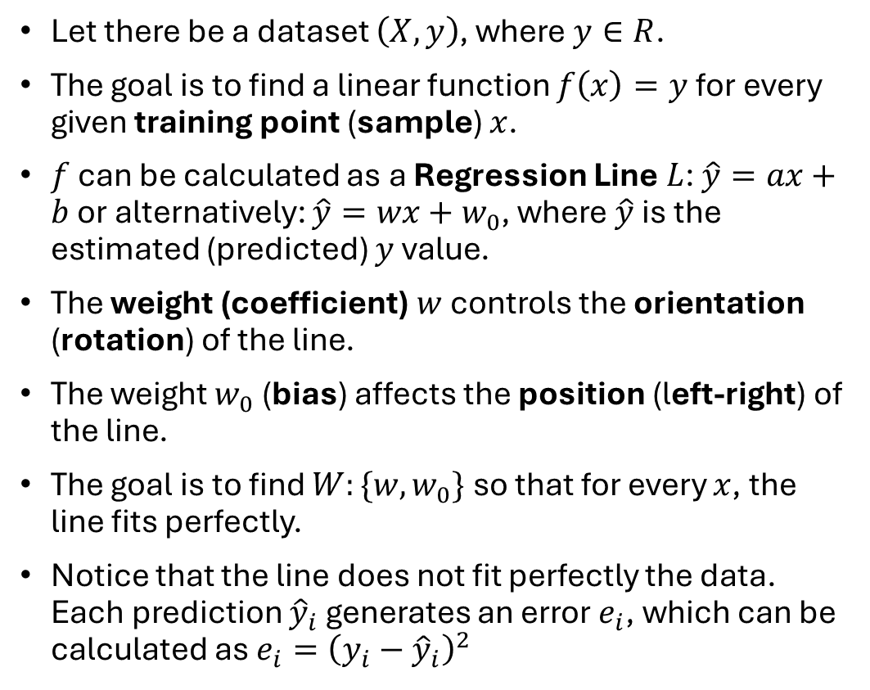



Linear Regression with 1 Feature
Let there be a dataset $\left(X,y\right)$, where $y∈R$.
The goal is to find a linear function $f\left(x\right)=y$ for every given training point (sample) $x$.
$f$ can be calculated as a Regression Line $L$: $\hat{y}=ax+b$or alternatively: $\hat{y}=wx+w_{0}$, where$\hat{y}$ is the estimated (predicted) $y$ value.
The weight (coefficient) $w$ controls the orientation (rotation) of the line.
The weight $w_{0}$ (bias) affects the position (left-right) of the line.
The goal is to find $W:\{w, w_{0}\}$ so that for every $x$, the line fits perfectly.
Notice that the line does not fit perfectly the data. Each prediction ${\hat{y}}_{i}$ generates an error $e_{i}$, which can be calculated as $e_{i}={\left(y_{i}−{\hat{y}}_{i}\right)}^{2}$
$$w$$
$$w_{0}$$
$$\hat{y}=wx+w_{0}$$

Slide 8
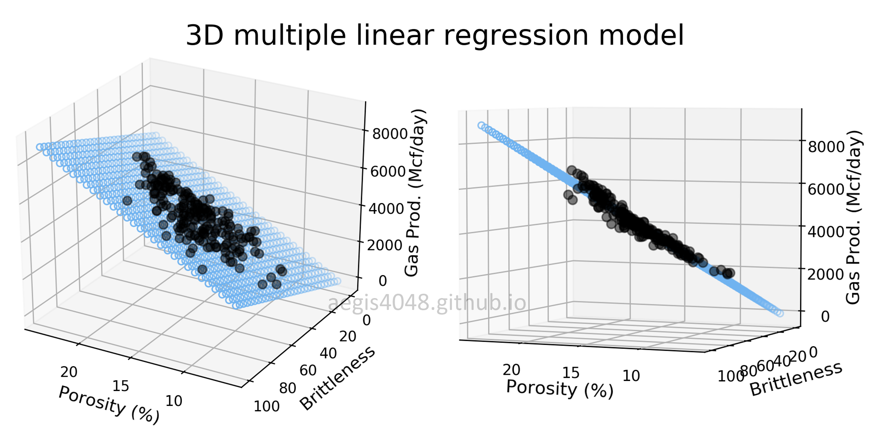
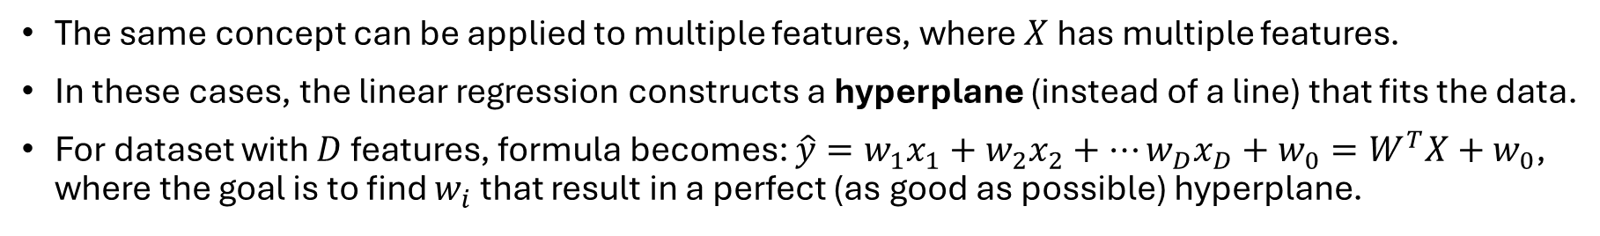
Linear Regression with Many Features
The same concept can be applied to multiple features, where $X$ has multiple features.
In these cases, the linear regression constructs a hyperplane (instead of a line) that fits the data.
For dataset with $D$ features, formula becomes: $\hat{y}=w_{1}x_{1}+w_{2}x_{2}+…w_{D}x_{D}+w_{0}=W^{T}X+w_{0}$, where the goal is to find $w_{i}$ that result in a perfect (as good as possible) hyperplane.

Slide 9
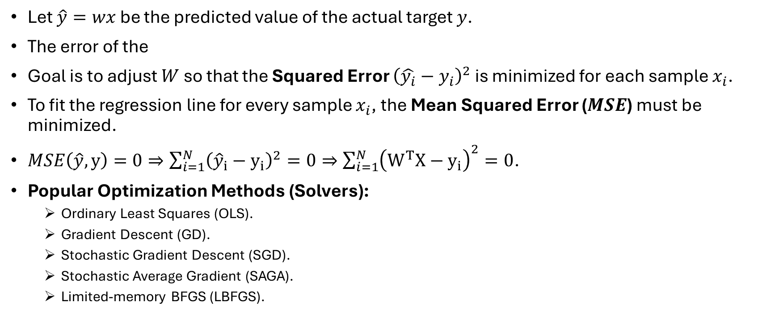
Linear Regression Solution
Let $\hat{y}=wx$ be the predicted value of the actual target $y$.
The error of the
Goal is to adjust $W$ so that the Squared Error ${\left(\hat{y_{i}}−y_{i}\right)}^{2}$ is minimized for each sample $x_{i}$.
To fit the regression line for every sample $x_{i}$, the Mean Squared Error ($MSE$) must be minimized.
$MSE\left(\hat{y},y\right)=0⇒\sum_{i=1}^{N}{{\left({\hat{y}}_{i}−y_{i}\right)}^{2}}=0⇒\sum_{i=1}^{N}{{\left(W^{T}X−y_{i}\right)}^{2}=0}$.
Popular Optimization Methods (Solvers):
Ordinary Least Squares (OLS).
Gradient Descent (GD).
Stochastic Gradient Descent (SGD).
Stochastic Average Gradient (SAGA).
Limited-memory BFGS (LBFGS).

Slide 10
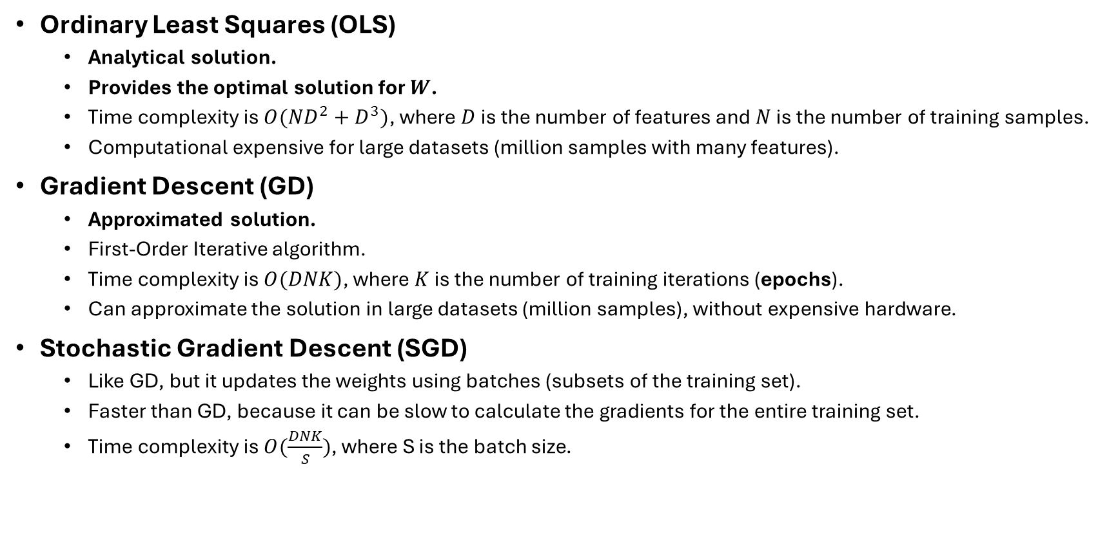
Optimization Methods (1)
Ordinary Least Squares (OLS)
Analytical solution.
Provides the optimal solution for $W$.
Time complexity is $O({ND}^{2}+D^{3})$, where $D$ is the number of features and $N$ is the number of training samples.
Computational expensive for large datasets (million samples with many features).
Gradient Descent (GD)
Approximated solution.
First-Order Iterative algorithm.
Time complexity is $O(DNK)$, where $K$ is the number of training iterations (epochs).
Can approximate the solution in large datasets (million samples), without expensive hardware.
Stochastic Gradient Descent (SGD)
Like GD, but it updates the weights using batches (subsets of the training set).
Faster than GD, because it can be slow to calculate the gradients for the entire training set.
Time complexity is $O(\frac{DNK}{S})$, where S is the batch size.

Slide 11
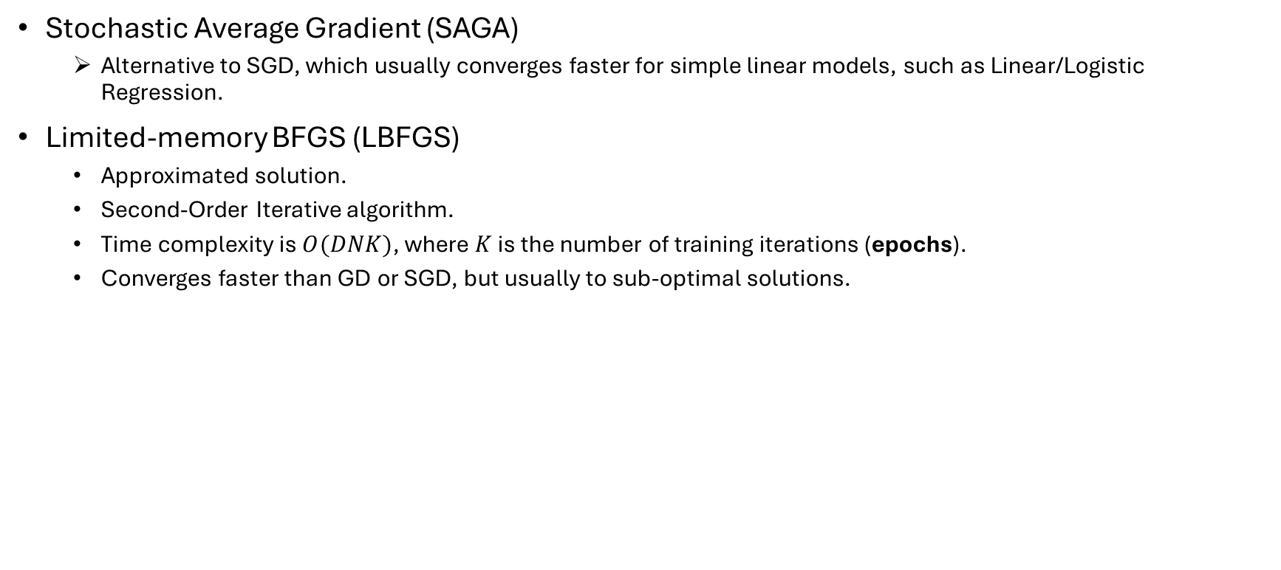
Optimization Methods (2)
Stochastic Average Gradient (SAGA)
Alternative to SGD, which usually converges faster for simple linear models, such as Linear/Logistic Regression.
Limited-memory BFGS (LBFGS)
Approximated solution.
Second-Order Iterative algorithm.
Time complexity is $O(DNK)$, where $K$ is the number of training iterations (epochs).
Converges faster than GD or SGD, but usually to sub-optimal solutions.

Slide 12
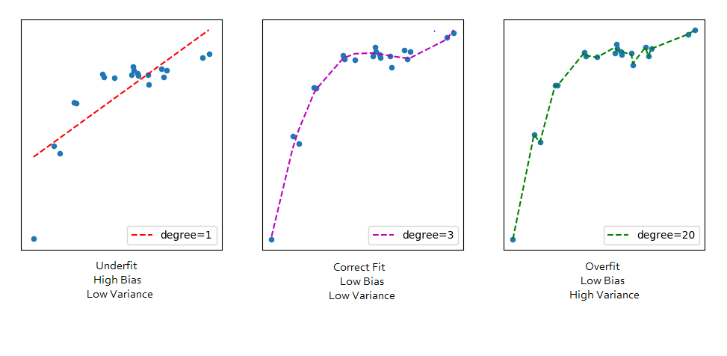
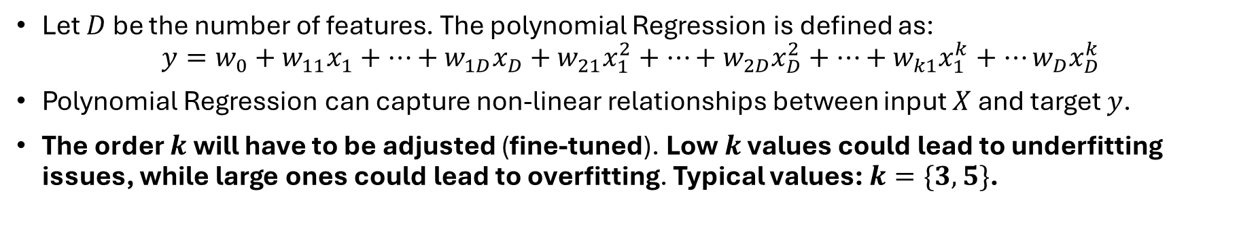
Polynomial Regression
Let $D$ be the number of features. The polynomial Regression is defined as:
$$y=w_{0}+w_{11}x_{1}+…+w_{1D}x_{D}+w_{21}x_{1}^{2}+…+w_{2D}x_{D}^{2}+…+w_{k1}x_{1}^{k}+…w_{D}x_{D}^{k}$$
Polynomial Regression can capture non-linear relationships between input $X$ and target $y$.
The order $k$ will have to be adjusted (fine-tuned). Low $k$ values could lead to underfitting issues, while large ones could lead to overfitting. Typical values: $k=\{3, 5\}$.

Slide 13
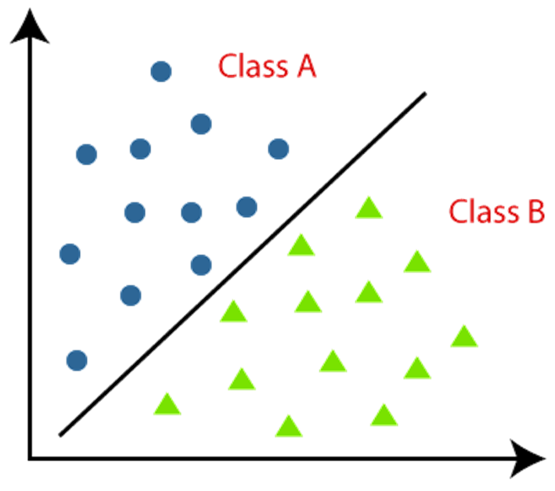
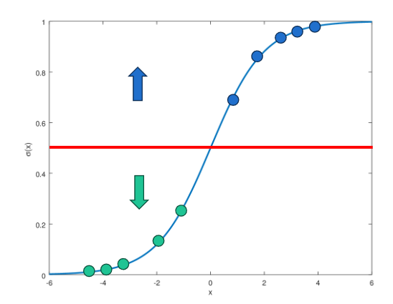







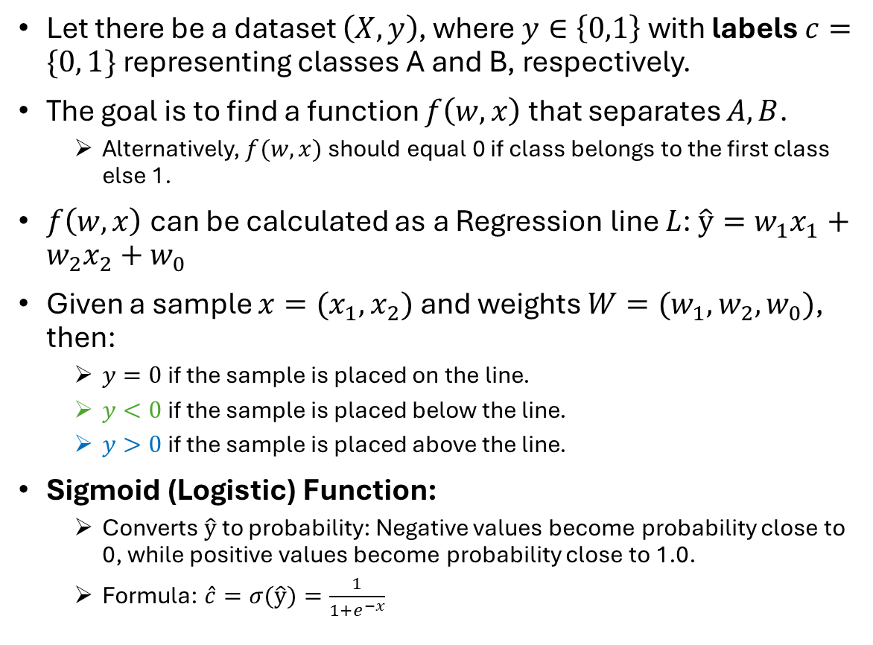
Logistic Regression
$$x_{2}$$
$y>0$
$L$: $\hat{y}=w_{1}x_{1}+w_{2}x_{2}+w_{0}$
Let there be a dataset $\left(X,y\right)$, where $y∈\left\{0,1\right\}$ with labels $c=\{0, 1\}$ representing classes A and B, respectively.
The goal is to find a function $f\left(w,x\right)$ that separates $A,B$.
Alternatively, $f(w,x)$ should equal 0 if class belongs to the first class else 1.
$f\left(w,x\right)$ can be calculated as a Regression line $L$: $\hat{y}=w_{1}x_{1}+w_{2}x_{2}+w_{0}$
Given a sample ${x=(x}_{1},x_{2})$ and weights $W=(w_{1},w_{2},w_{0})$, then:
$y=0$ if the sample is placed on the line.
$y<0$ if the sample is placed below the line.
$y>0$ if the sample is placed above the line.
Sigmoid (Logistic) Function:
Converts $\hat{y}$ to probability: Negative values become probability close to 0, while positive values become probability close to 1.0.
Formula: $\hat{c}=σ(\hat{y})=\frac{1}{1+e^{−x}}$
$y<0$
$$x_{1}$$
$y>0.5$
$y<0.5$

Slide 14
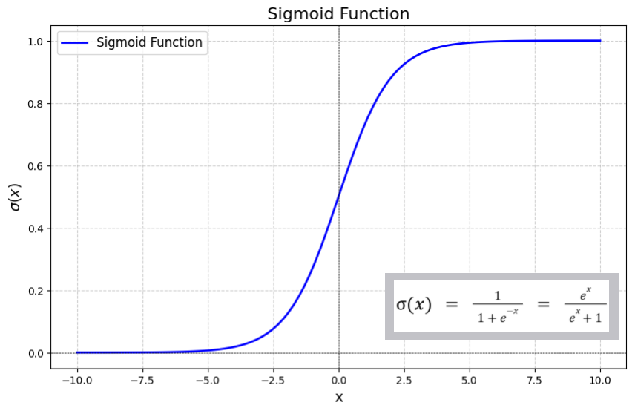
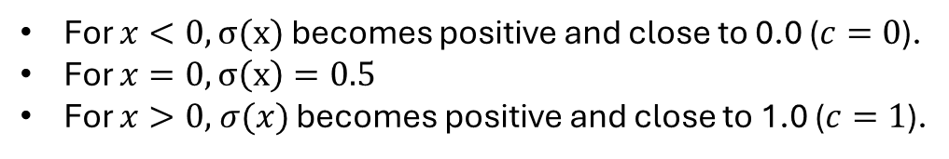
Sigmoid (Logistic) Function:
For $x<0, σ(x)$ becomes positive and close to 0.0 ($c=0$).
For $x=0, σ\left(x\right)=0.5$
For $x>0,$ $σ(x)$ becomes positive and close to 1.0 ($c=1$).

Slide 15





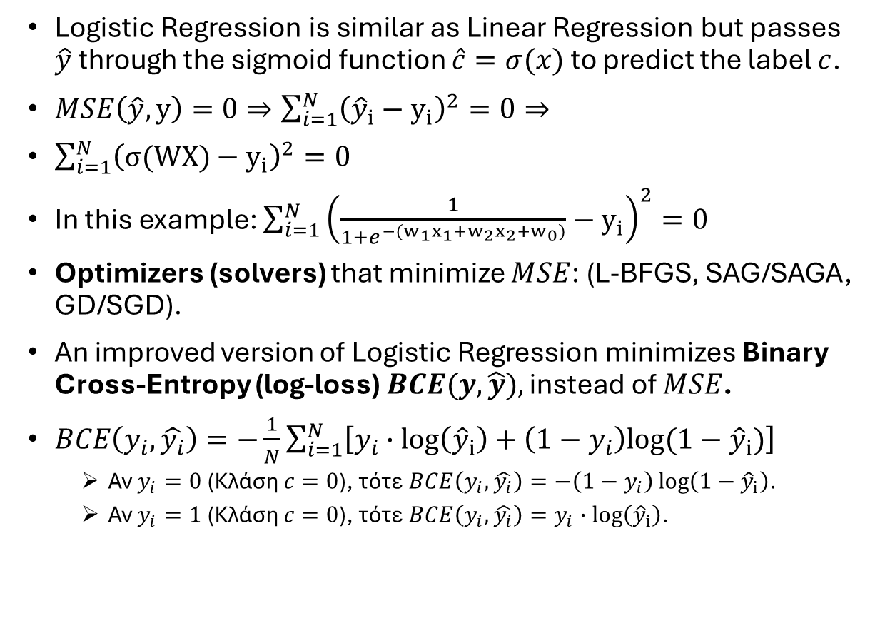
Optimizing Logistic Regression
$$x_{2}$$
$y>0$
$L$: $\hat{y}=w_{1}x_{1}+w_{2}x_{2}+w_{0}$
$y<0$
Logistic Regression is similar as Linear Regression but passes $\hat{y}$ through the sigmoid function $\hat{c}=σ(x)$ to predict the label $c$.
$MSE\left(\hat{y},y\right)=0⇒\sum_{i=1}^{N}{{\left({\hat{y}}_{i}−y_{i}\right)}^{2}}=0⇒$
$\sum_{i=1}^{N}{{\left(σ(WX)−y_{i}\right)}^{2}=0}$
In this example: $\sum_{i=1}^{N}{{\left(\frac{1}{1+e^{−(w_{1}x_{1}+w_{2}x_{2}+w_{0})}}−y_{i}\right)}^{2}=0}$
Optimizers (solvers) that minimize $MSE$: (L-BFGS, SAG/SAGA, GD/SGD).
An improved version of Logistic Regression minimizes Binary Cross-Entropy (log-loss) $BCE(y, \hat{y}),$ instead of $MSE$.
$BCE\left(y_{i}, \hat{y_{i}}\right)=−\frac{1}{N}\sum_{i=1}^{N}{\left[y_{i}∙\log\left({\hat{y}}_{i}\right)+\left(1−y_{i}\right)log⁡(1−{\hat{y}}_{i})\right]}$
Αν $y_{i}=0$ (Κλάση $c=0$), τότε $BCE\left(y_{i}, \hat{y_{i}}\right)=−\left(1−y_{i}\right)\log\left(1−{\hat{y}}_{i}\right)$.
Αν $y_{i}=1$ (Κλάση $c=0$), τότε $BCE\left(y_{i}, \hat{y_{i}}\right)=y_{i}∙\log\left({\hat{y}}_{i}\right)$.
$$x_{1}$$

Slide 16
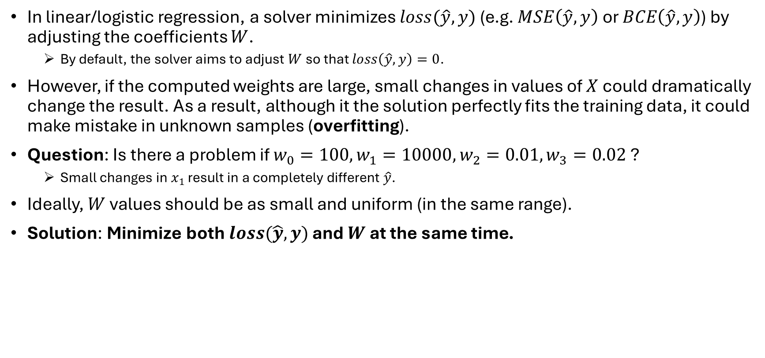
Regularization
In linear/logistic regression, a solver minimizes $loss(\hat{y},y)$ (e.g. $MSE\left(\hat{y},y\right)$ or $BCE\left(\hat{y},y\right)$) by adjusting the coefficients $W$.
By default, the solver aims to adjust $W$ so that $loss\left(\hat{y},y\right)=0$.
However, if the computed weights are large, small changes in values of $X$ could dramatically change the result. As a result, although it the solution perfectly fits the training data, it could make mistake in unknown samples (overfitting).
Question: Is there a problem if $w_{0}=100, w_{1}=10000, w_{2}=0.01, w_{3}=0.02$?
Small changes in $x_{1}$ result in a completely different $\hat{y}$.
Ideally, $W$ values should be as small and uniform (in the same range).
Solution: Minimize both$loss(\hat{y},y)$ and $W$ at the same time.

Slide 17
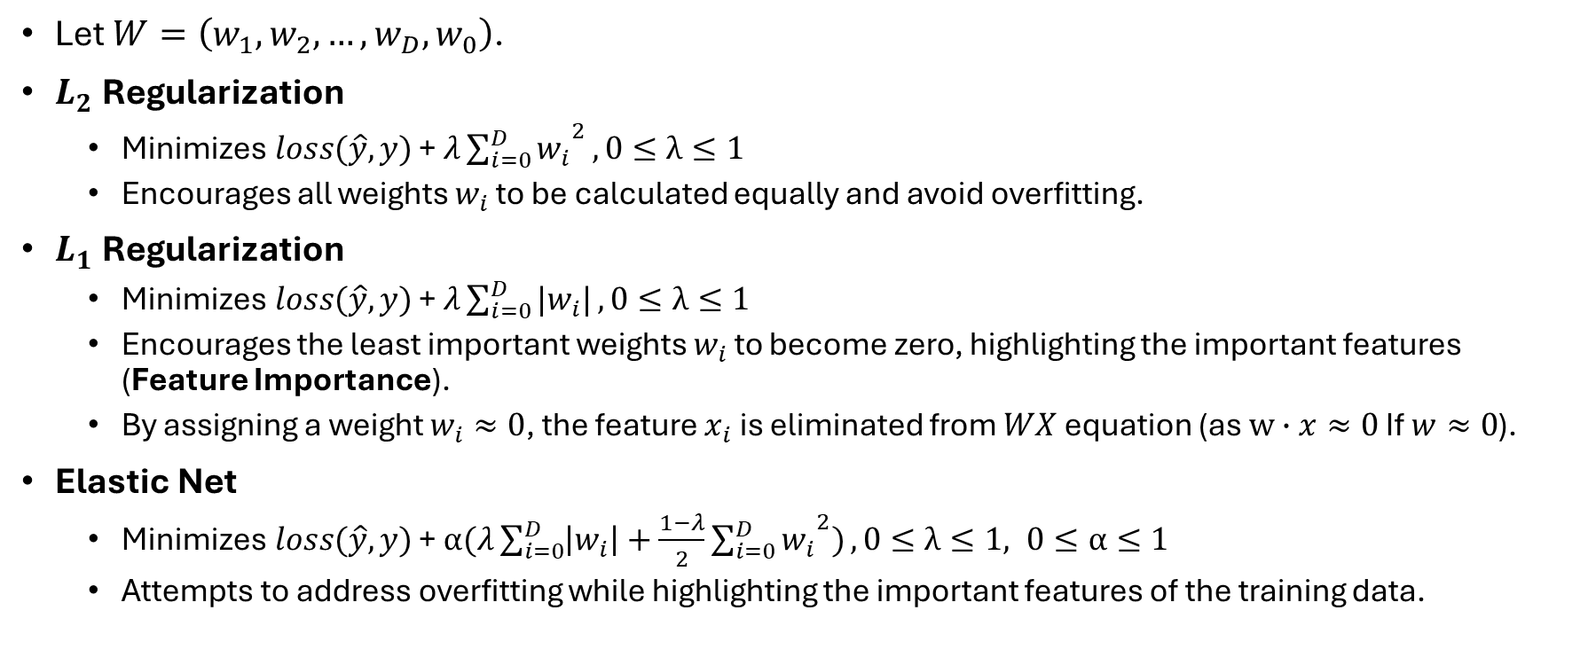
Regularization Penalties
Let $W=\left(w_{1},w_{2},…,w_{D},w_{0}\right)$.
$L_{2}$ Regularization
Minimizes$loss(\hat{y},y)$ + $λ{\sum_{i=0}^{D}{w_{i}}}^{2},0≤λ≤1$
Encourages all weights $w_{i}$ to be calculated equally and avoid overfitting.
$L_{1}$ Regularization
Minimizes$loss(\hat{y},y)$ + $λ\sum_{i=0}^{D}{|w_{i}|},0≤λ≤1$
Encourages the least important weights $w_{i}$ to become zero, highlighting the important features (Feature Importance).
By assigning a weight $w_{i}≈0$, the feature $x_{i}$ is eliminated from $WX$ equation (as $w∙x≈0$ If $w≈0$).
Elastic Net
Minimizes$loss(\hat{y},y)$ + $α(λ\sum_{i=0}^{D}{\left|w_{i}\right|+\frac{1−λ}{2}{\sum_{i=0}^{D}{w_{i}}}^{2})},0≤λ≤1, 0≤α≤1$
Attempts to address overfitting while highlighting the important features of the training data.

Slide 18
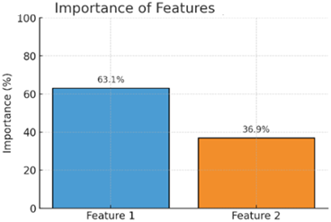

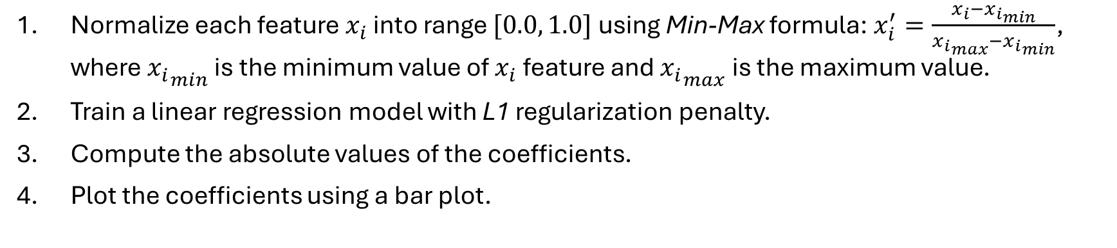
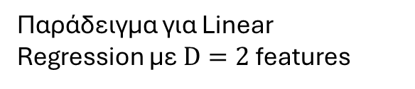
Coefficient Analysis
Normalize each feature $x_{i}$ into range $[0.0, 1.0]$ using Min-Max formula: $x_{i}^{′}=\frac{x_{i}−{x_{i}}_{min}}{{x_{i}}_{max}−{x_{i}}_{min}}$, where ${x_{i}}_{min}$ is the minimum value of $x_{i}$ feature and ${x_{i}}_{max}$ is the maximum value.
Train a linear regression model with L1 regularization penalty.
Compute the absolute values of the coefficients.
Plot the coefficients using a bar plot.
$${|w}_{i}|$$
Παράδειγμα για Linear Regression με $D=2$ features

Slide 19
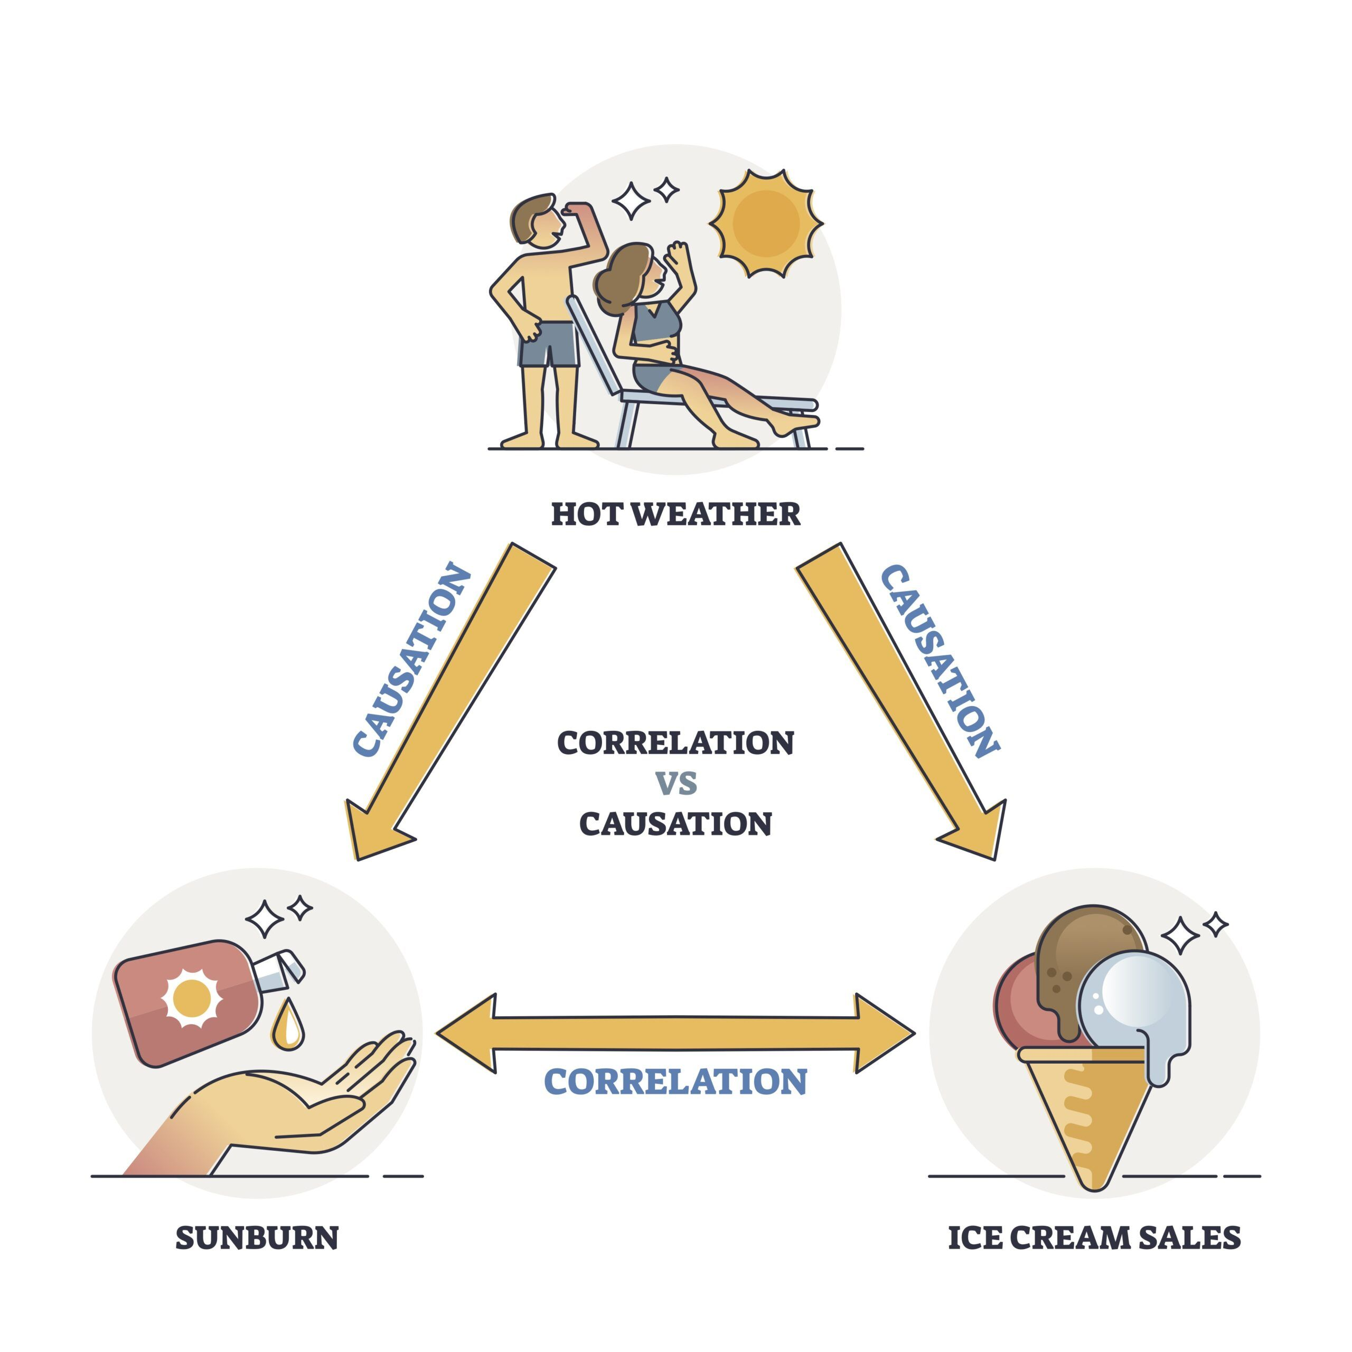
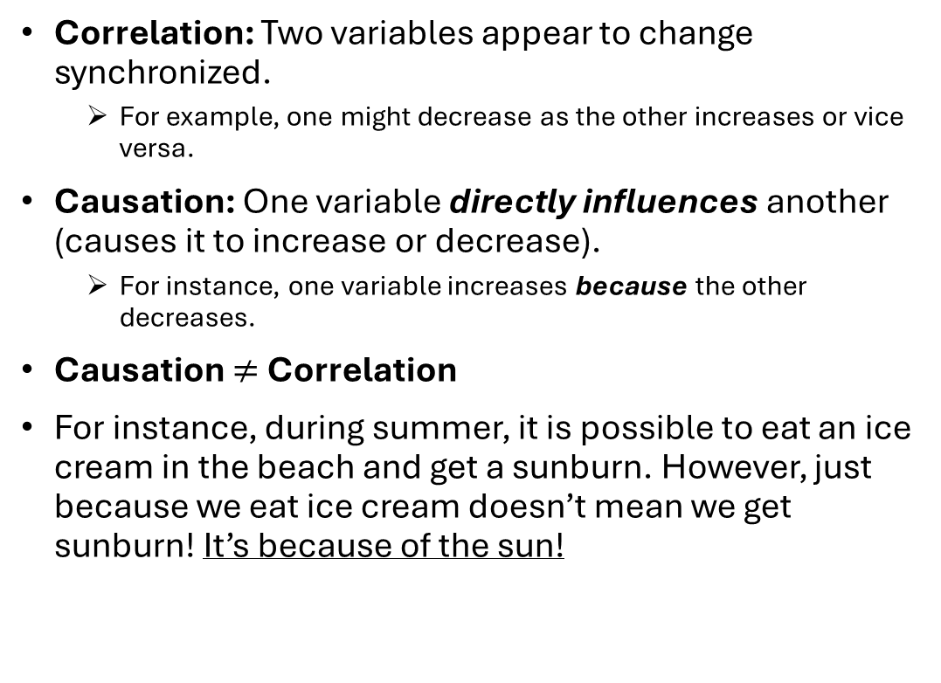
Correlation vs Causation
Correlation: Two variables appear to change synchronized.
For example, one might decrease as the other increases or vice versa.
Causation: One variable directly influences another (causes it to increase or decrease).
For instance, one variable increases because the other decreases.
Causation $≠$ Correlation
For instance, during summer, it is possible to eat an ice cream in the beach and get a sunburn. However, just because we eat ice cream doesn’t mean we get sunburn! It’s because of the sun!

Slide 20
Machine Learning
Linear Regression Notes

